Slide 1
Web Scraping Task
PRATEEK KEERTHI
(Web Developer)

Slide 2
Initial Understanding of Problem
Scrape the data from the given resources
Store the data in the database tables based on the outputs expected
Generate API’s for displaying the data that is stored in the database

Slide 3
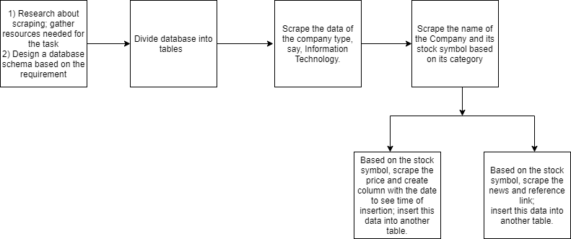
Project Implementation Flow

Slide 4
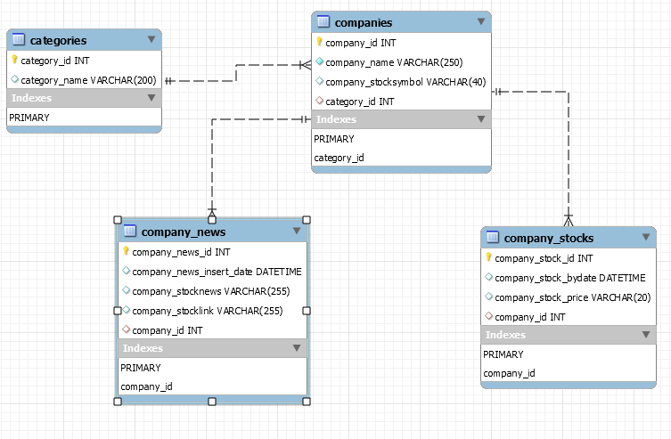
Database Schema

Slide 5
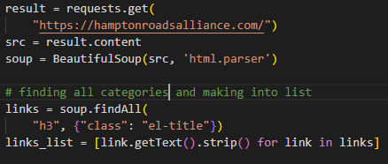
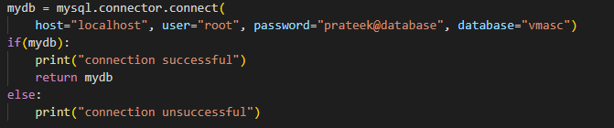
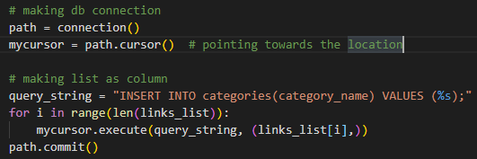
Scraping I: Categories
Scraped all the categories from the
website using BeautifulSoup
and made into a list.
Created database connection
later pushed it into table named
‘Categories’.
Packages Used:
BeautifulSoup
mysql.connector

Slide 6
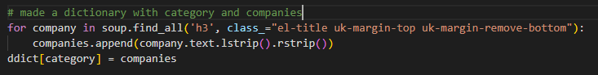
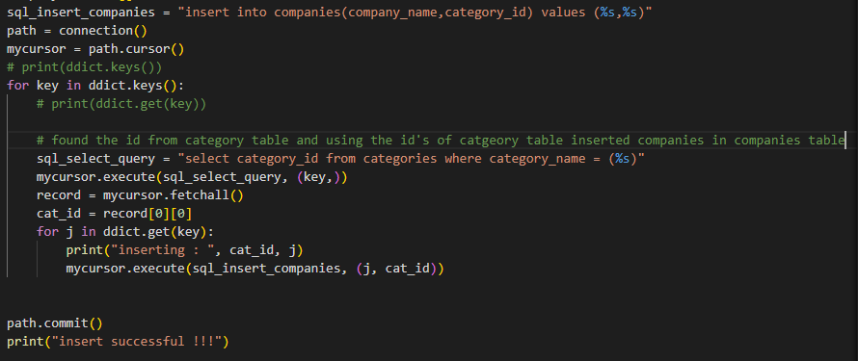
Scraping II: Company Names, Stocks
Scraped the companies and
stored them in a dictionary format
of “category”:”company”
Inserted companies into
companies table
Problems Faced:
Stock symbols:
Parent company stocks
Can Use:
Screener

Slide 7
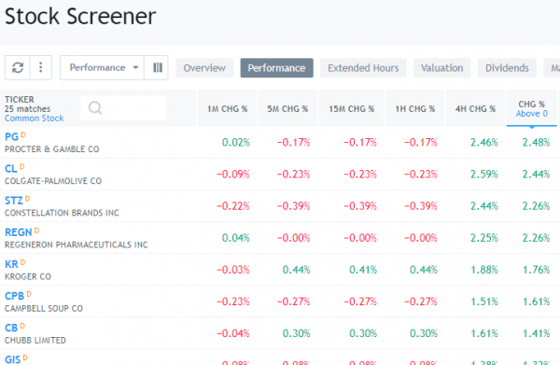
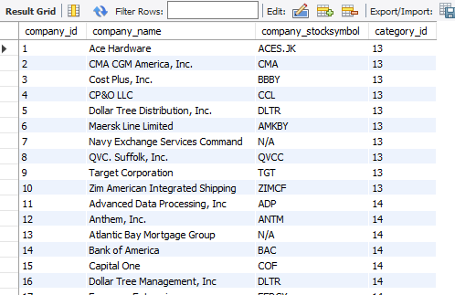
Screener
Private firms who make database for companies and their stock symbols

Slide 8
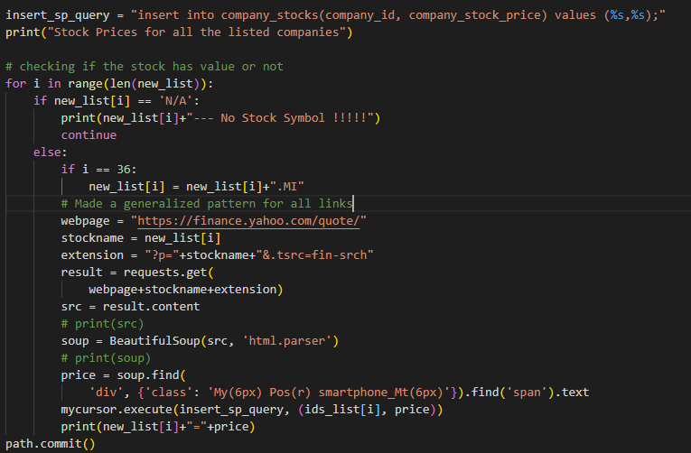
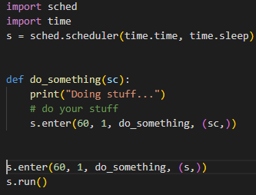
Scraping III: Stock Price
Checked if the company had a
stock or not
Found a generalized pattern for
searching
Inserted Stock price into table
To store continuous data for
stock price used packages:
Time, Scheduler Package
Methods used:
Hierarchical approach
Patterns in link

Slide 9
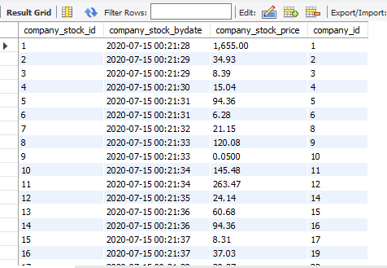
Stock Price Table

Slide 10
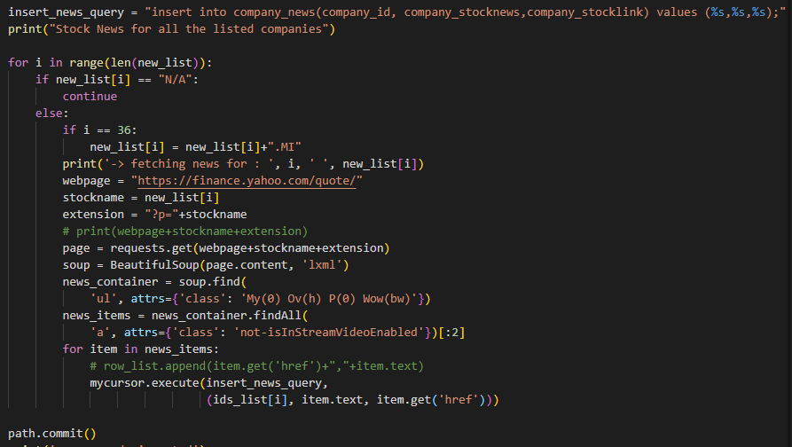
Scraping IV: Stock News
Checking for company
stock
Scraped first two news
articles and relevant links
of it
Found the pattern for links
Used hierarchical method
for scraping news
Problems Faced:
News based on time

Slide 11
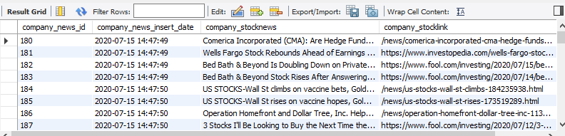
Stock News Table

Slide 12
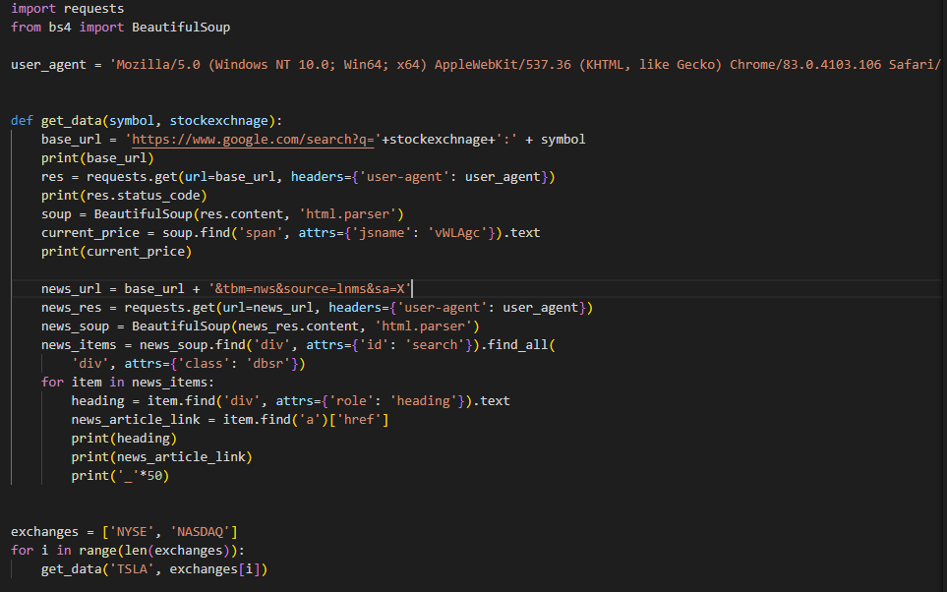
Scraping News from Google Finance
Initially, I had issues
scraping data from Google
Finance.
I read on forums that it
wasn’t legal, so I found
an interesting resource
that helped me with the
process.
Reference link:
Scrape Hero

Slide 13
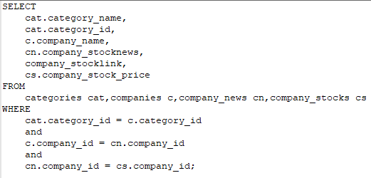
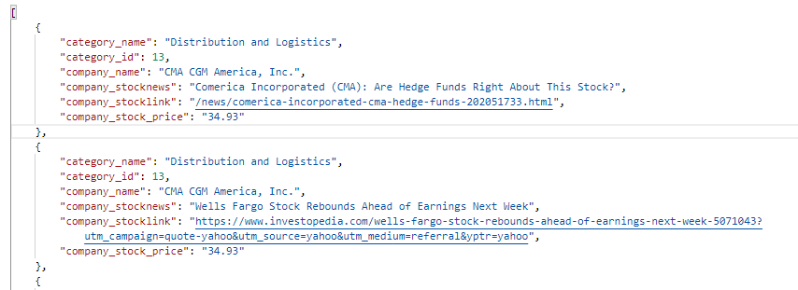
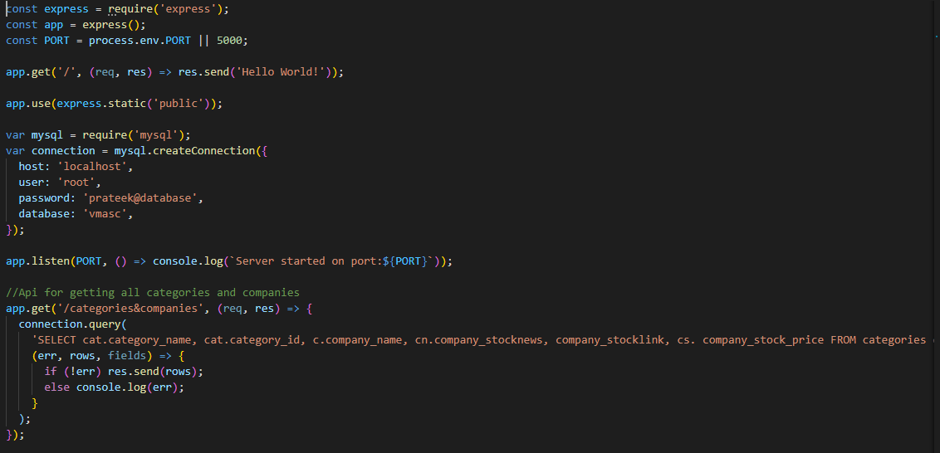
Express:
Fetched data from the mysql and
used express server to generate api

Slide 14
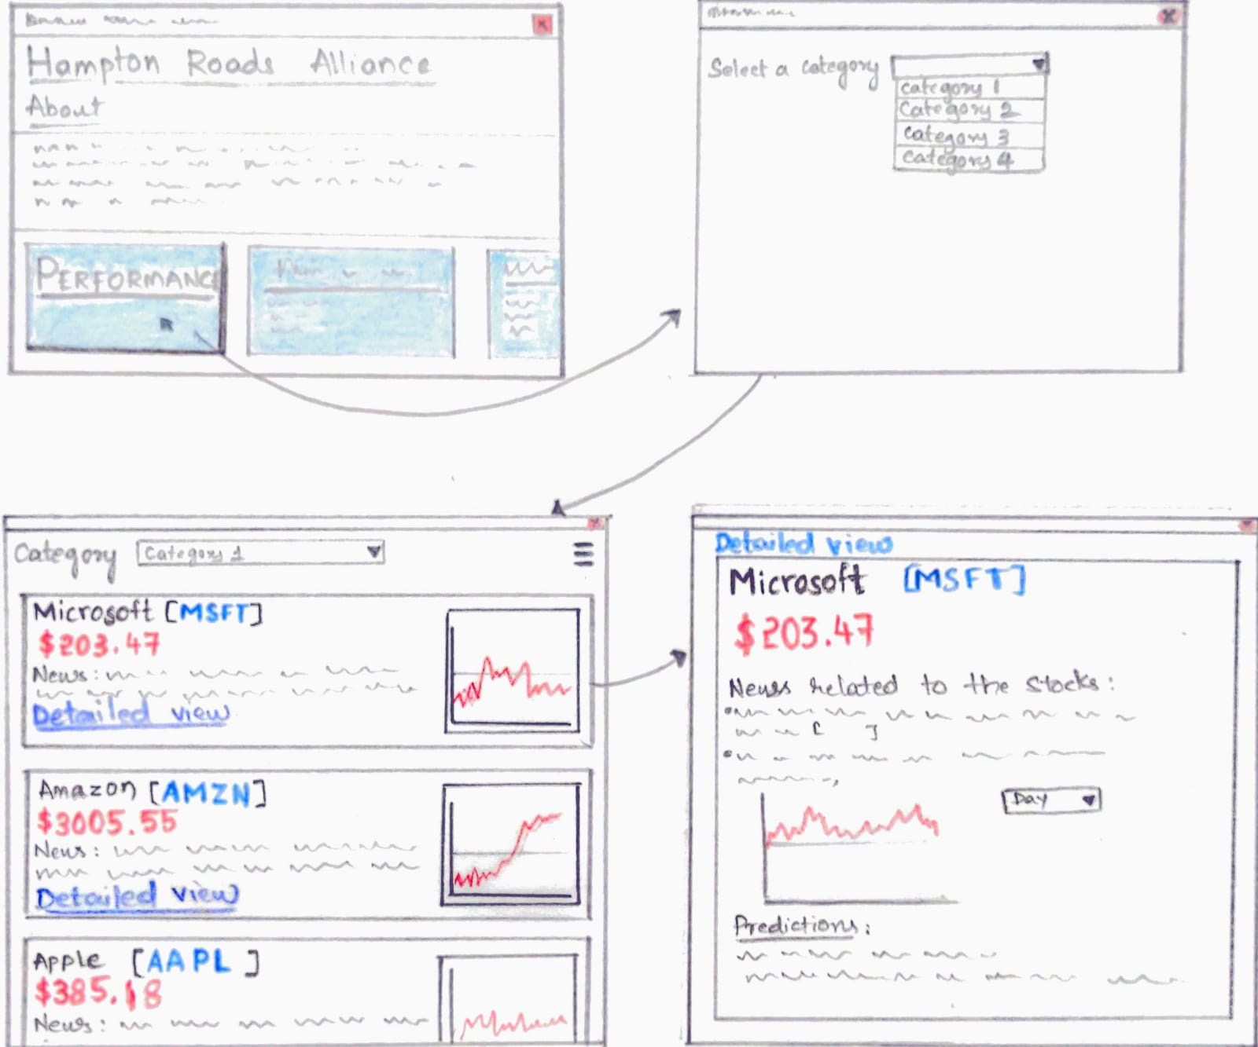
Future Proposals:
Using Python, I wanted to generate visualizations for the data stored in MySQL database.
Try to identify the correlation between the news and the stock price for that day.
Make predictions for the stock in future using Machine Learning.

Slide 15
Solution when working in a Team
Divide the tasks between two major teams – Front End and Back End.
Front End team works on retrieving the data from the API and displaying on a UI.
Back End team can be further divided to two teams – one team works on designing the database and generating APIs.
The other team scrapes the data from the available resources and store it in a database team. This team could work as a Database Management Team.
If you consider future proposals, an additional team is required. This team will be working on machine learning part where they have to predict the stocks and also analyze the trends.

Slide 16
Thank you!
Print(“Any Questions…?”)

